Slide 1


Team 27: GAN Assisted Map Reconstruction for first responders using Sensor Fusion
Quinn LeBoeuf, Rufus Tadpatri, Christian Jeardoe, Kyle Smejkal Sponsor: Swarnabha Roy TA: Niloofar Borzooei
Bi-Weekly Update 1
Notes:
Michelle

Slide 2
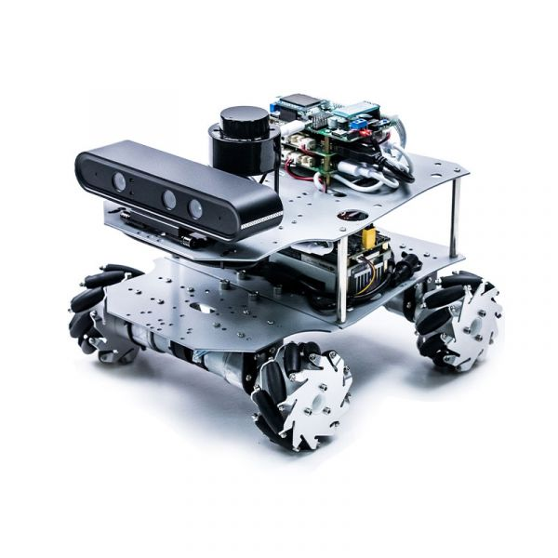
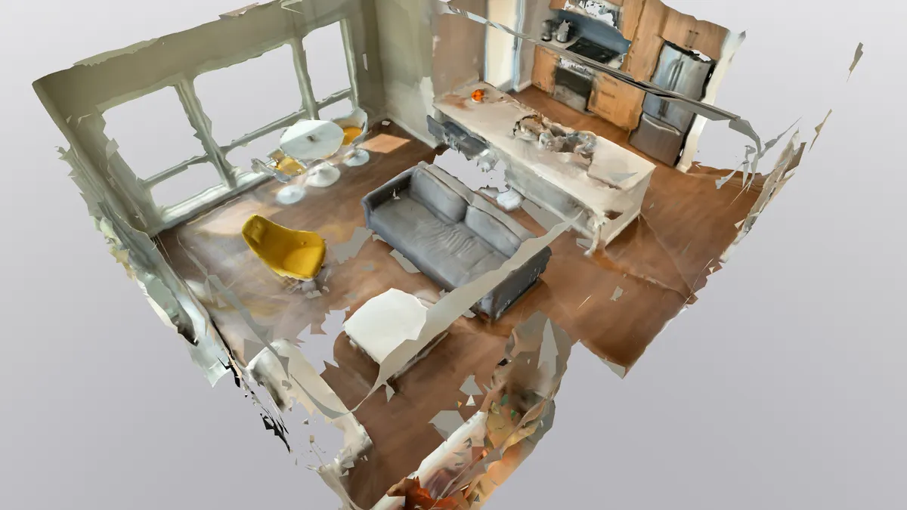
Project Summary
Emergency situations often require first responders to enter dangerous environments with minimal information. (fires, gas leak, rescues)
Create a multi sensor, GAN assisted, map reconstruction program that can be utilized on a mobile platform to create a virtual 3D twin of any environment.
Notes:
Kyle

Slide 3
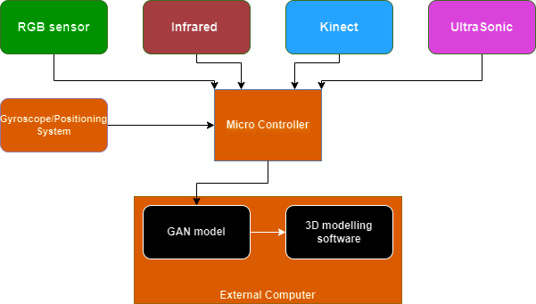
Project/Subsystem Overview
Rufus
Kyle
Christian
Quinn
Each subsystem has its required sensor inputting data into a GAN model and creating a 3D point cloud
GAN models vary in their tasks depending on the sensor
RealSense
Notes:
Eric

Slide 4
Major Project Changes for 404
Major Changes:
Ultrasonic Subsystem LiDAR Subsystem
- Unable to process data from ultrasonic sensor data into depth map/point cloud data properly.
- Sponsor allowed a change in sensor to LiDAR given these circumstances.
Point cloud fusion
- Some sensors create significantly more accurate point clouds.
- attempting to improve point cloud from best sensor with a less accurate sensor may be redundant.
Notes:
Eric

Slide 5
Project Timeline
Subsystem components researched and collected
Subsystems complete and demonstrated
Subsystem integration overview and project revisions made
Subsystems made ready for integration and additional parts aquired
Subsystems integrated and full project demonstrated
Notes:
Eric

Slide 6
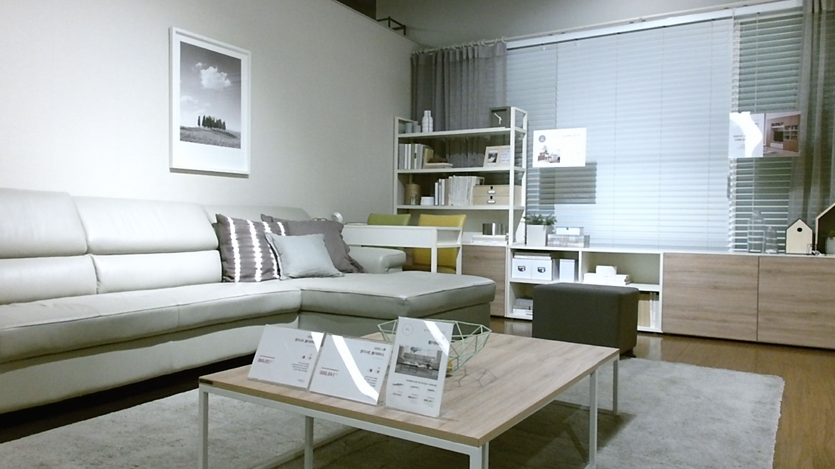
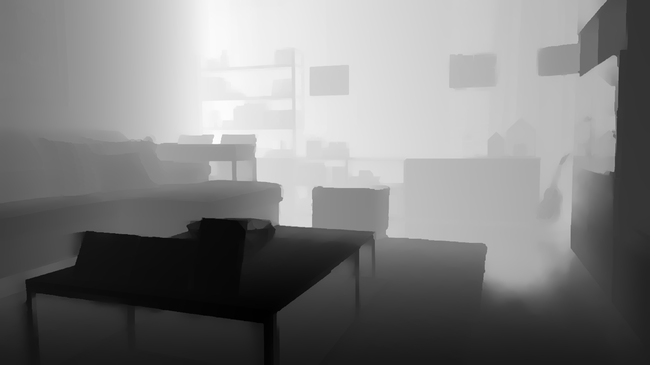
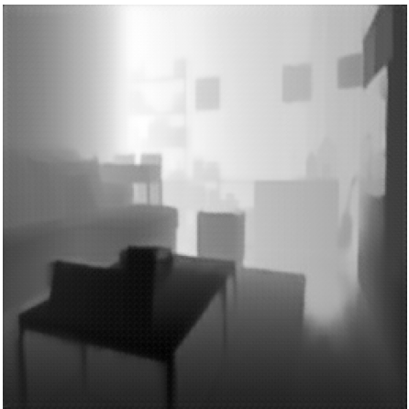
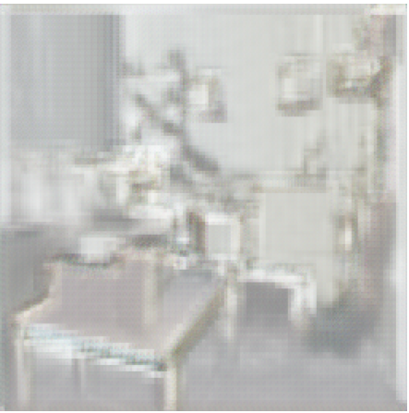
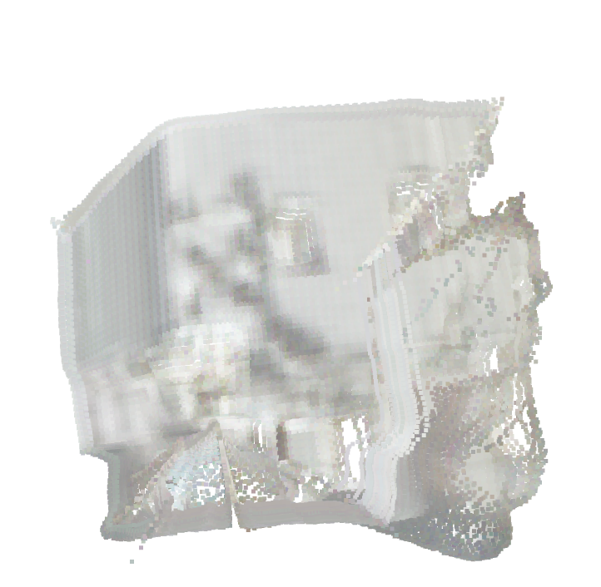
LiDAR SubSystem
Quinn LeBoeuf
Accomplishments since 403 (10 hours) | Ongoing progress/problems and plans until the next presentation
research in implementing data processing from ultrasonic sensor (proven to be not doable). (7) LiDAR research for new sensor and chosen LiDAR. (3) | Receive data from LiDAR sensor. Tweak GAN model to train and improve LiDAR point cloud. Find new training dataset for the changed GAN model.
Previous GAN model processing:
RGB Image | Depth map (noisy or clean) | Improved Depth Map | Inferred RGB Image | Point cloud
(GROUND TRUTH) | (INPUT DATA) | (OUTPUT DATA) | (PROCESSED OUTPUT)

Slide 7
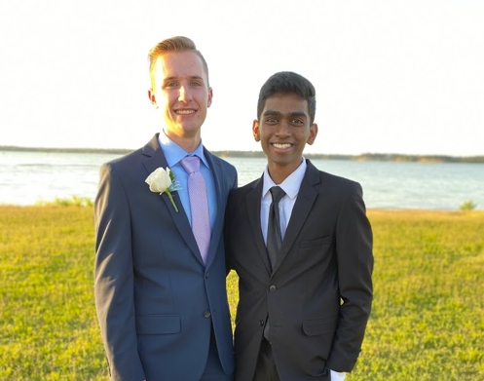
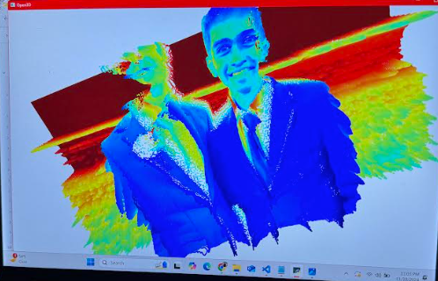
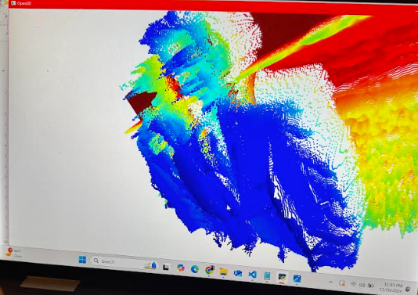
RGB Sensor Subsystem
Rufus Tadpatri
Accomplishments since 403 (5 hours) | Ongoing progress/problems and plans until the next presentation
Research into robot (2) Feasibility of options for robot chassis and mounting (3) | Ongoing integration amongst four sensors Programming robot chassis to motor control
Current GAN model performance:

Slide 8
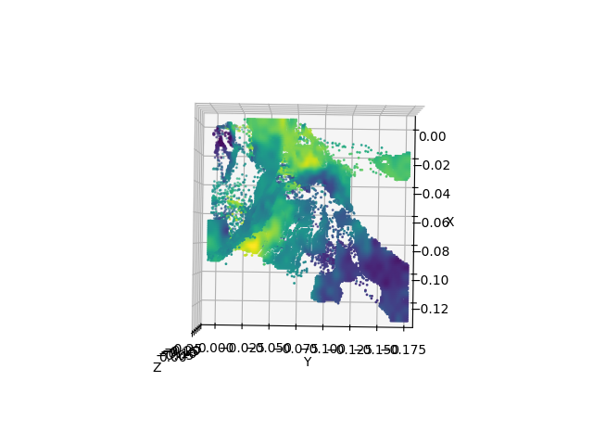
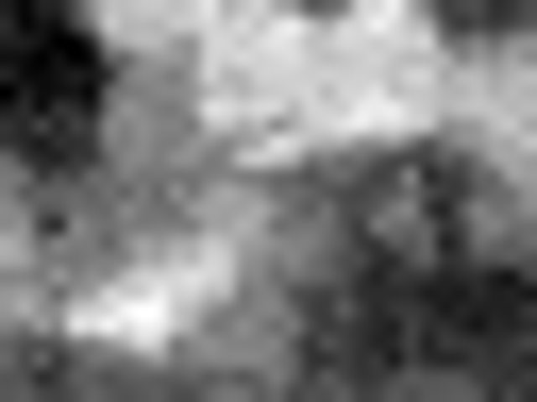
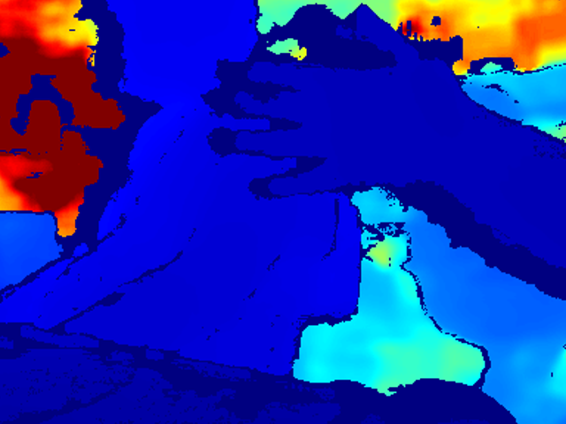
Infrared Sensor SubSystem
Kyle Smejkal
Accomplishments since 403 (5 hours) | Ongoing progress/problems and plans until the next presentation
Research into replacement sensor and equipment needed to run it. (2) Bug fixing program. (3) | Low resolution Inefficient point cloud Get more training data

Slide 9
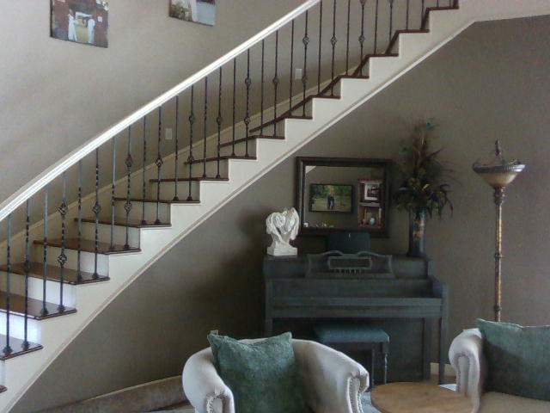
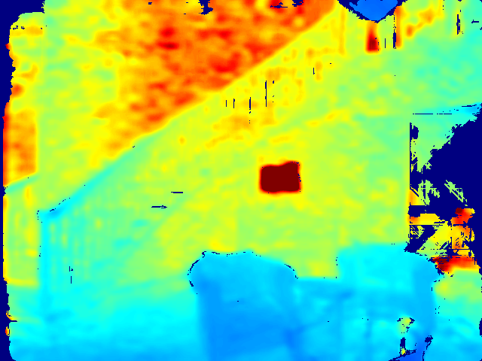
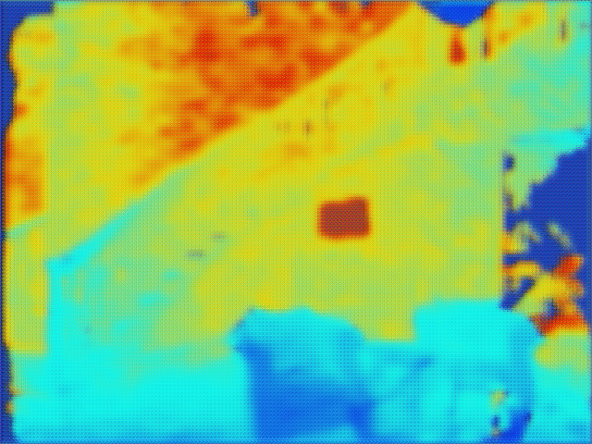
RealSense SubSystem
Christian Jeardoe
Accomplishments since 403 (5 hours) | Ongoing progress/problems and plans until the next presentation
Research for Inertial Measurement Unit (3) Research and decision on 3D rendering engine (2) | Linking several separate programs for one concise workflow Integrate subsystem and IMU with robot platform and 3D display engine
Current GAN model performance:
RGB Image | Raw Sensor Depth Map Output | Improved Depth Map_______

Slide 10
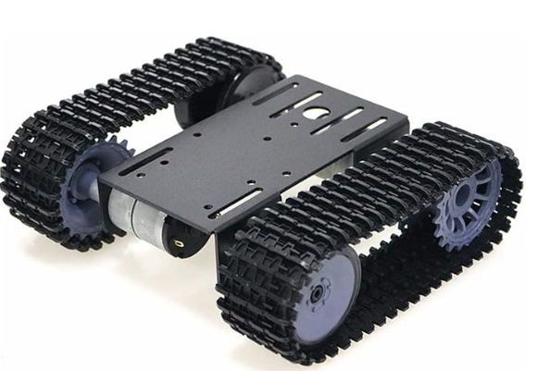
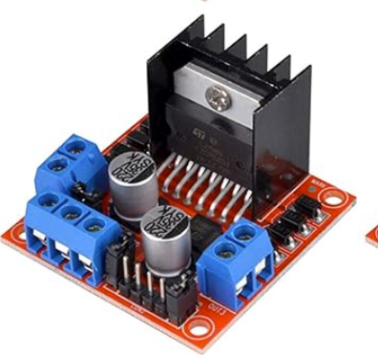
Parts Ordering Status
Robot chassis (Ordered)
Motor controller (Ordered)
multiScan100 LiDAR (sponsor provided)
Inertial Measurement Unit (IMU) (Ordered)
All ordered parts are expected to be ready by Feb 5th to begin integration.
Notes:
Michelle

Slide 11
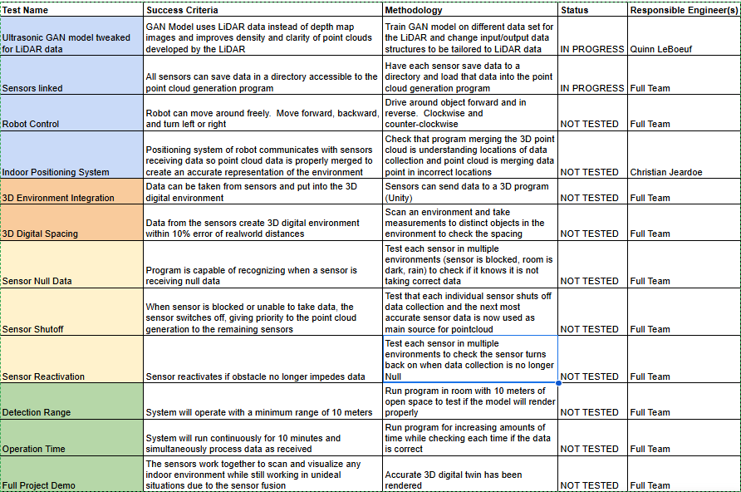
Validation Plan
Notes:
Michelle

Slide 12
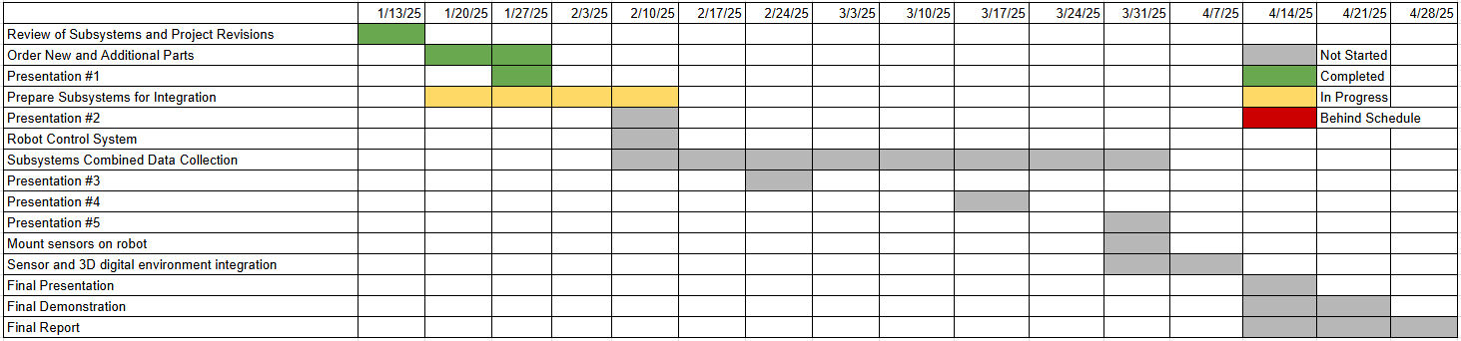
Execution Plan

Slide 13
Thank you for your time

